Slide 1
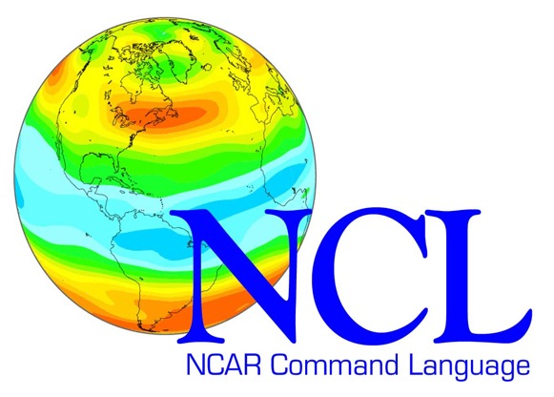


Using the NCAR Command Language (NCL) (or, you don’t have to use Python!)
Michael C. Coniglio
Research Meteorologist
NOAA/National Severe Storms Laboratory (NSSL)
AMS Student Conference
January 6, 2019

Slide 2
Python vs. NCL
Like Python, NCL
Is an interpreted, interactive scripting language (no need for specific computer architecture to compile and use the program)
Has robust file handling (netCDF, ascii, GRIB2, etc.)
Has data analysis functions built in
Can produce publication-quality graphics
Is highly customizable
Is free and open source
Has quirks that can drive you mad at times
Slower than compiled languages (Fortran, C, etc.) for intensive computations/looping (but NCL does have an algebra that supports much-faster array operations)
Unlike Python, NCL
Was developed specifically for scientific data processing and visualization in Earth-science related fields (Python has broader applications for computational science, like Matlab).
Has a syntax very similar to Fortran-90

Slide 3
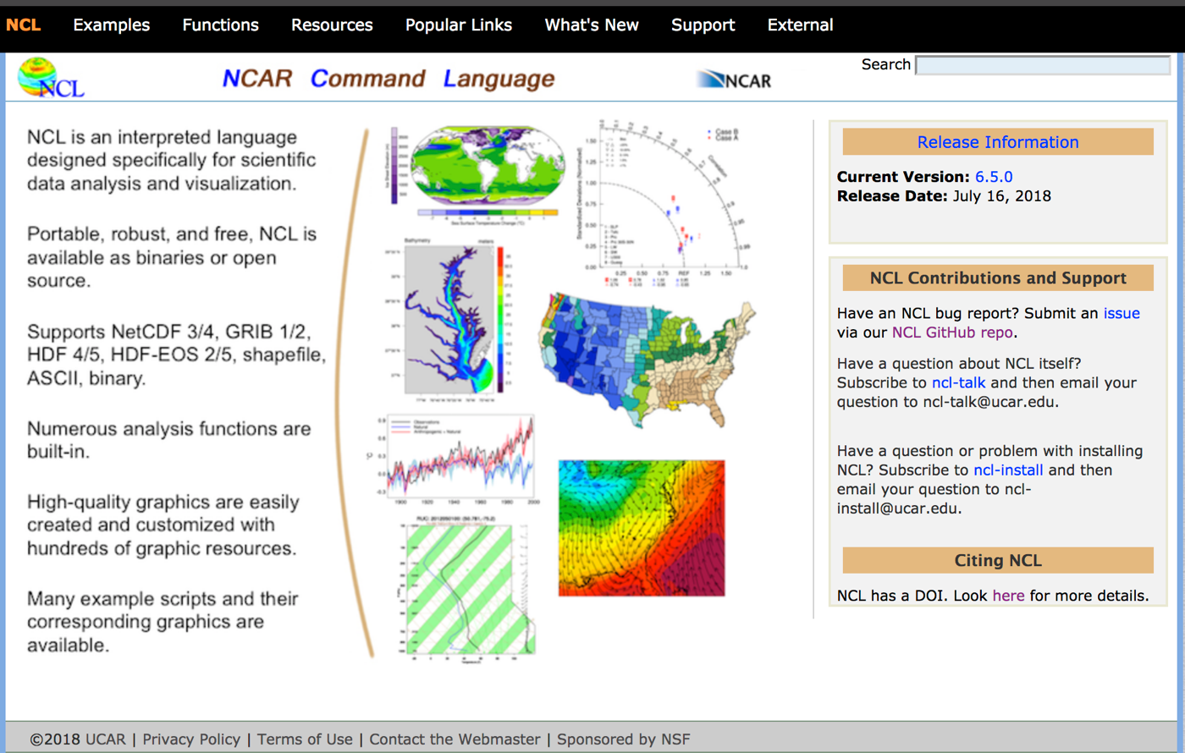
Support/development is outstanding
http://www.ncl.ucar.edu

Slide 4
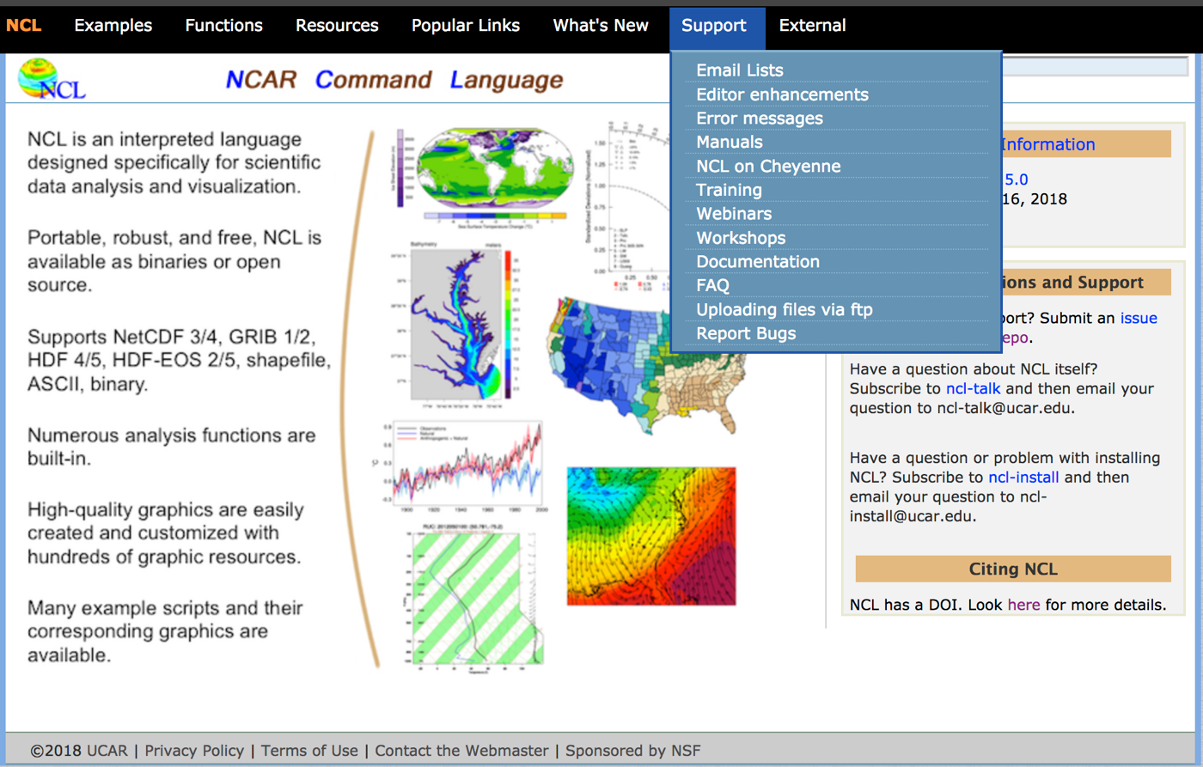
Support/development is outstanding
http://www.ncl.ucar.edu

Slide 5
Examples, examples, examples!
http://www.ncl.ucar.edu

Slide 6
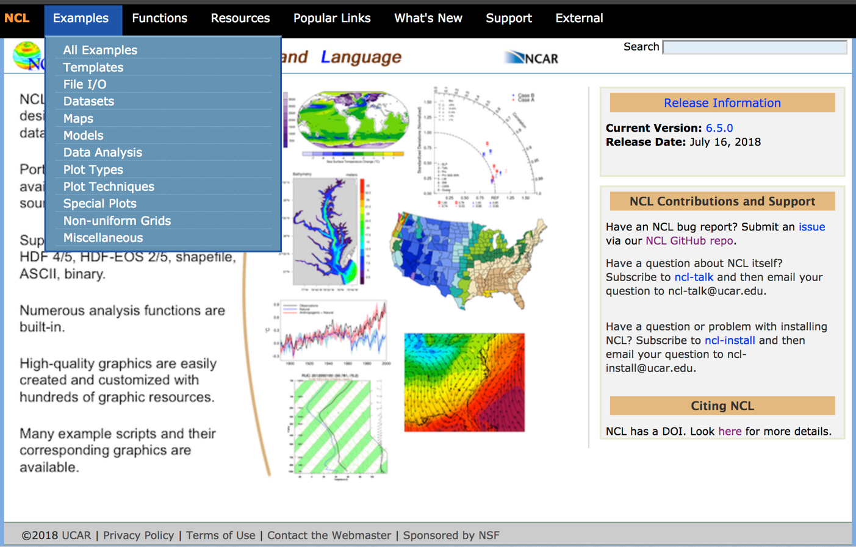
Examples, examples, examples!
http://www.ncl.ucar.edu

Slide 7
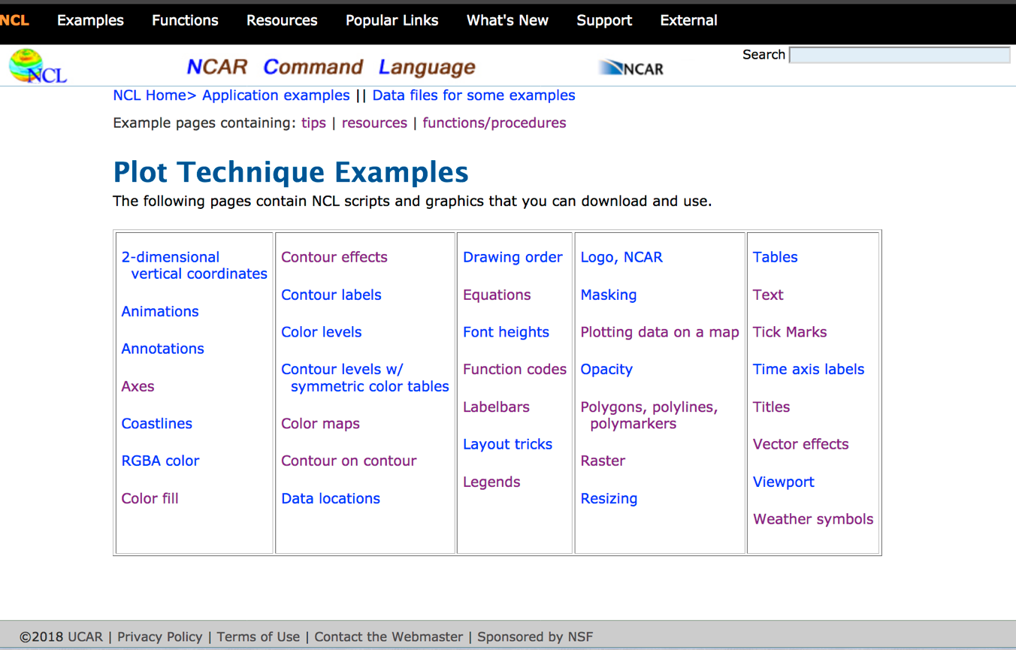
Examples, examples, examples!

Slide 8
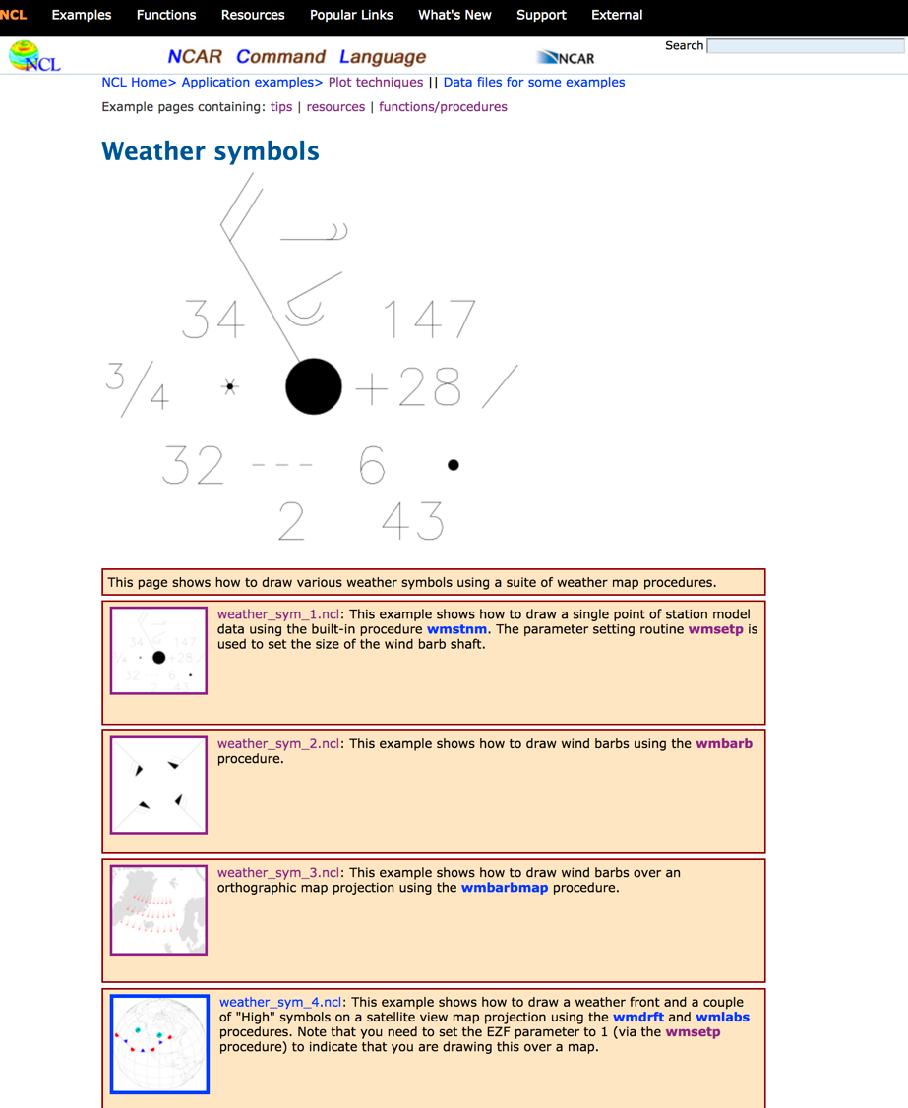
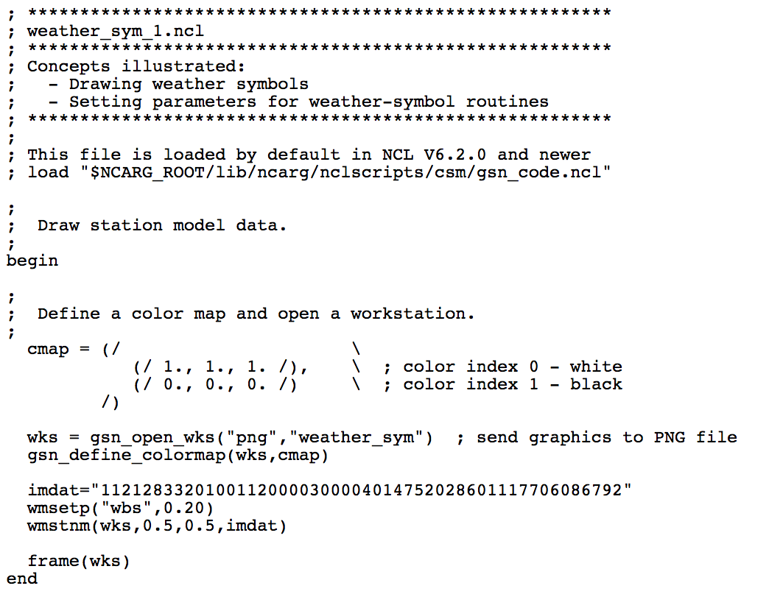

Slide 9
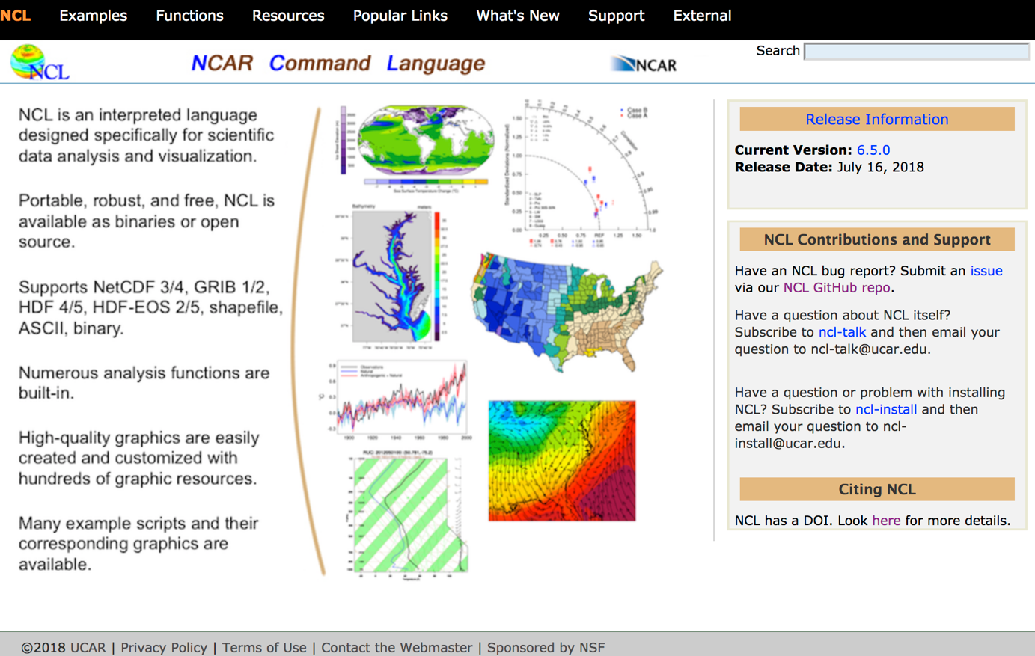
http://www.ncl.ucar.edu

Slide 10
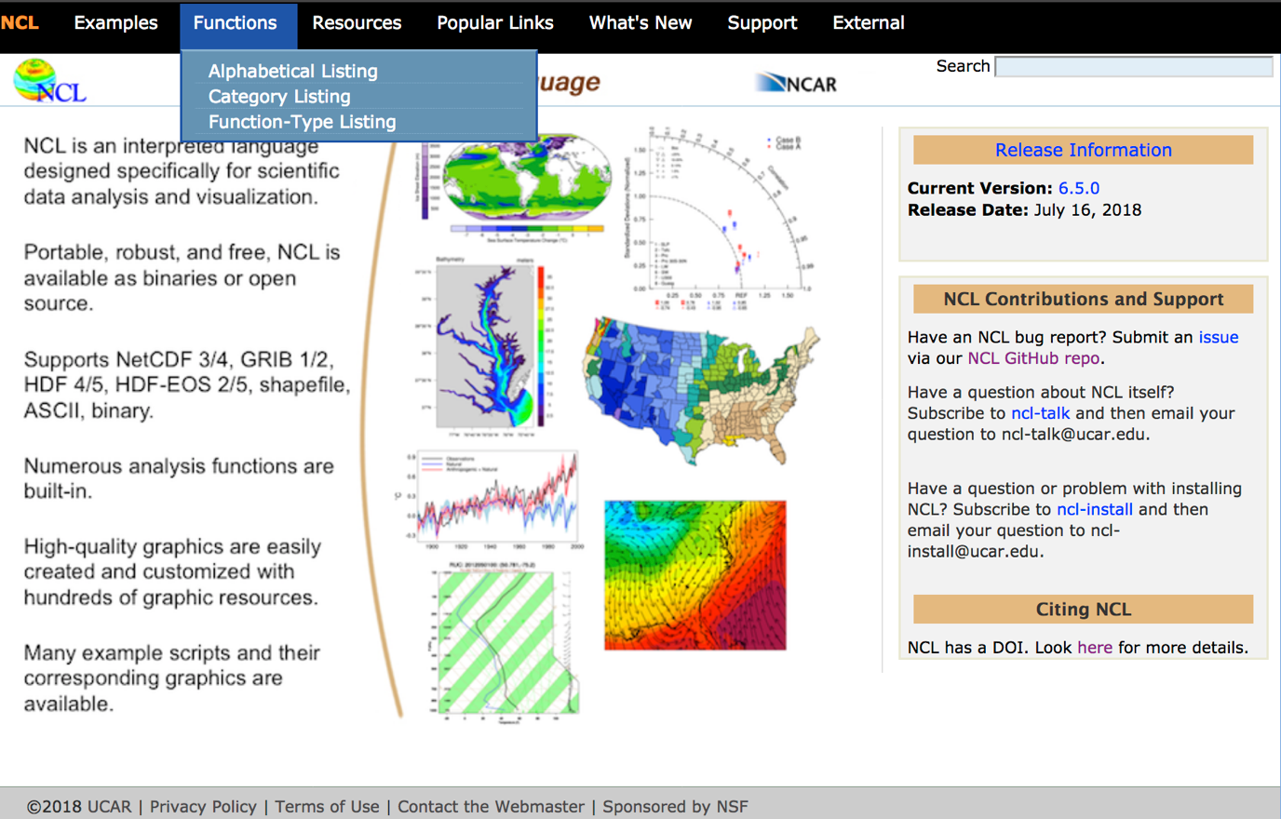
http://www.ncl.ucar.edu

Slide 11
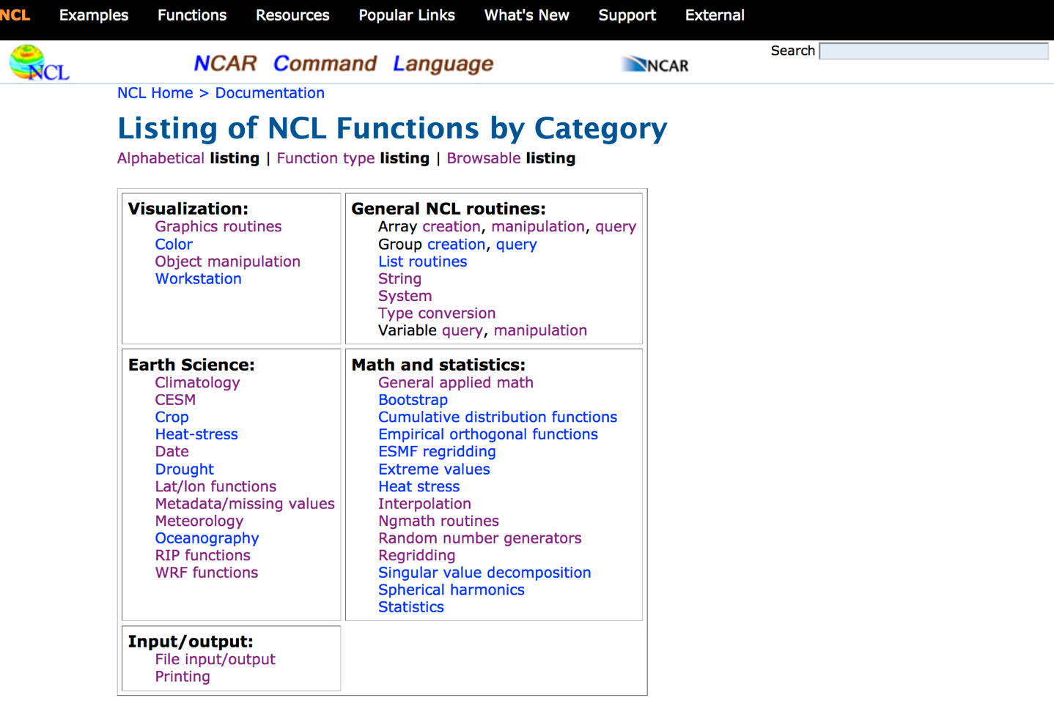

Slide 12
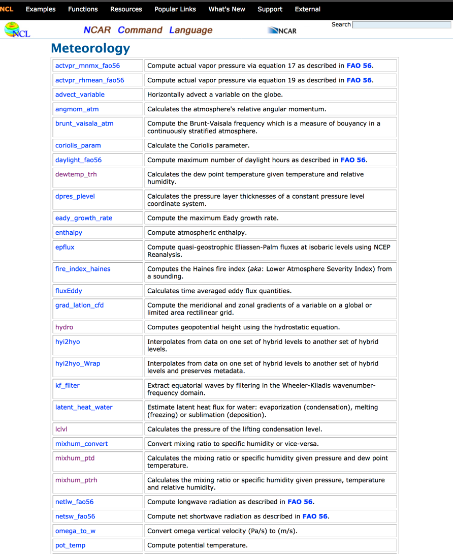

Slide 13
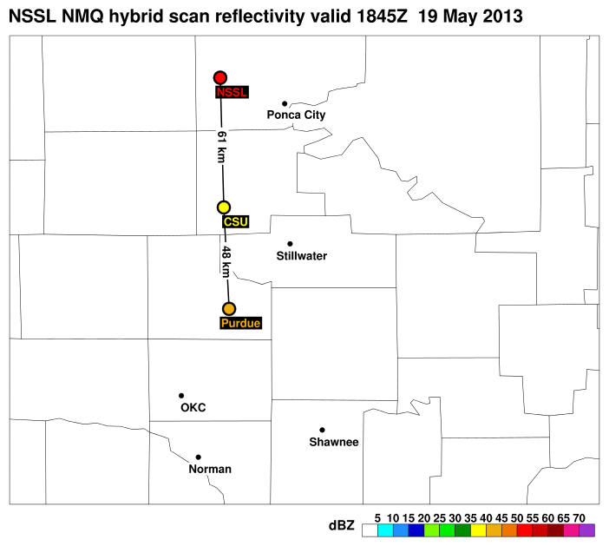
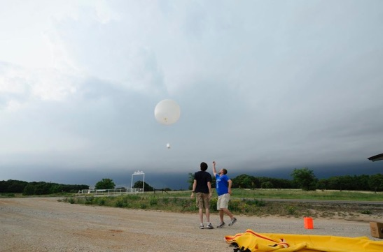
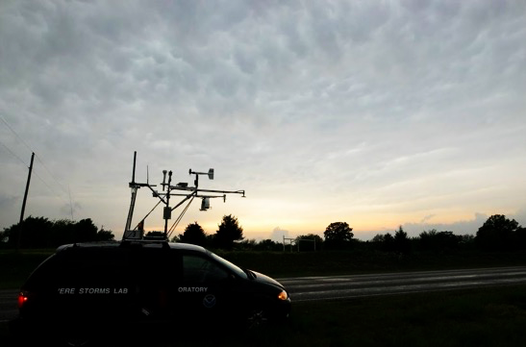
Mesoscale Predictability Experiment (MPEX)
Trapp, R.J., D.J. Stensrud, M.C. Coniglio, R.S. Schumacher, M.E. Baldwin, S. Waugh, and D.T. Conlee, 2016: Mobile Radiosonde Deployments during the Mesoscale Predictability Experiment (MPEX): Rapid and Adaptive Sampling of Upscale Convective Feedbacks. Bull. Amer. Meteor. Soc., 97, 329–336.

Slide 14
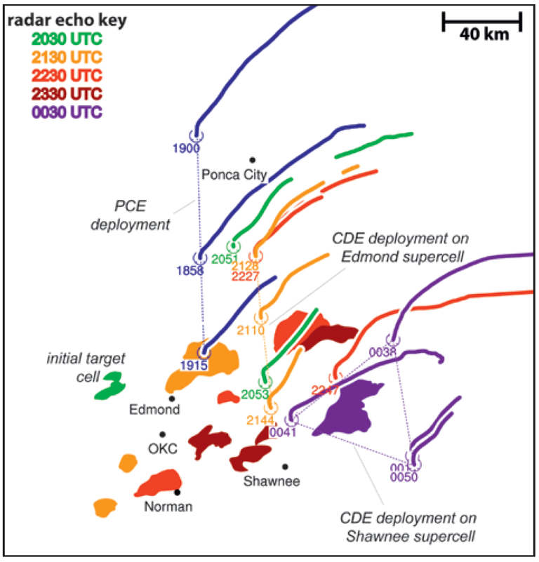
Mesoscale Predictability Experiment (MPEX)
Trapp, R.J., D.J. Stensrud, M.C. Coniglio, R.S. Schumacher, M.E. Baldwin, S. Waugh, and D.T. Conlee, 2016: Mobile Radiosonde Deployments during the Mesoscale Predictability Experiment (MPEX): Rapid and Adaptive Sampling of Upscale Convective Feedbacks. Bull. Amer. Meteor. Soc., 97, 329–336.

Slide 15
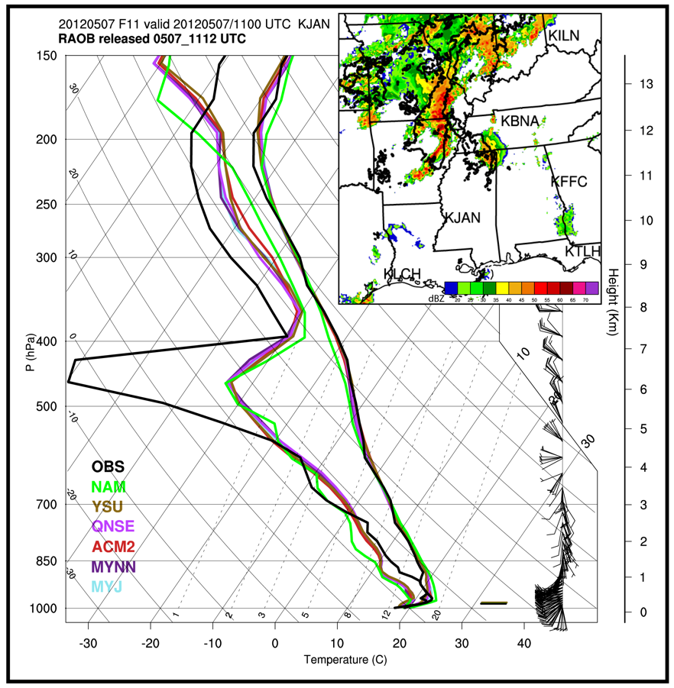
Excellent functions for skewT-logP diagrams

Slide 16
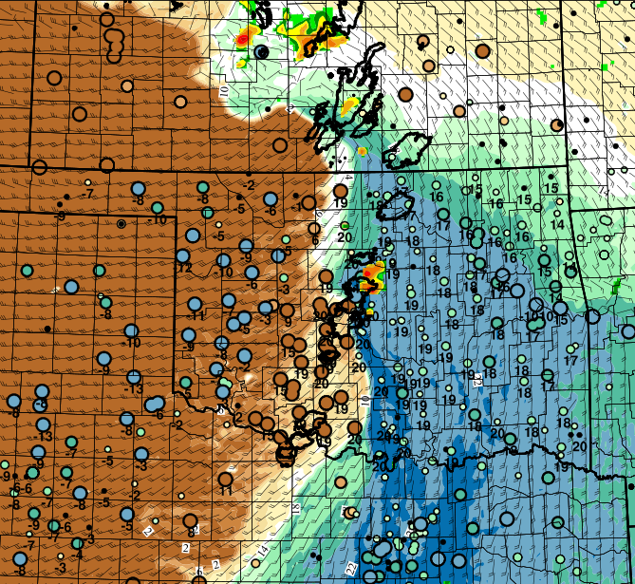
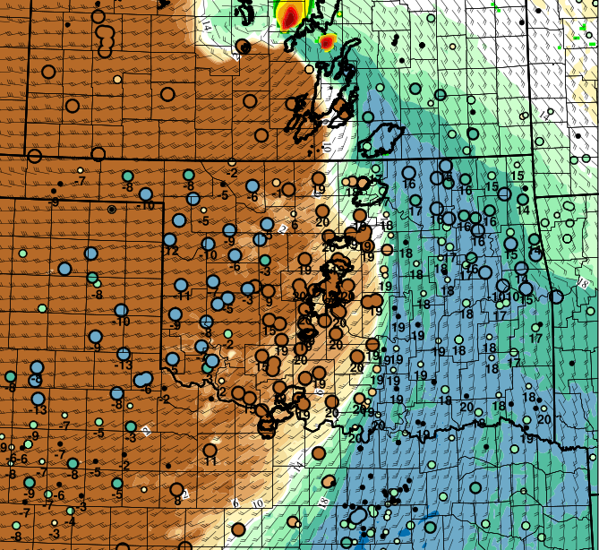
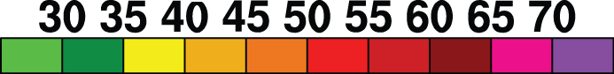
Flexibility to get creative
: Observed reflectivity ≥ 40 dBZ
: Simulated reflectivity
: Observed dryline
: Observed dewpoint (°C)
Tfcst - Tob
(°C)
##
too dry
too moist
model forecasts of surface dewpoint valid 22 UTC 10 May 2010
Model A
Model B
dBZ
°C

Slide 17
In Summary
You can be a scientist without Python!
NCL is a well-supported, flexible, earth-scientist-centric alternative
Excellent complement with Fortran (for more intensive computational needs)
http://www.ncl.ucar.edu
“Python/NCL: Free alternatives for Earth Scientists”, Nicolas Barrier, Institute on Research and Development, UMR Marbec, Marseille, France

